Slide 2
Sustainable materials: which metal?

Slide 3
Do you think that metal is a sustainable material?
Meeting the needs of all people now without having a negative impact on the needs of people living in the future.
Why do you think this?
Sustainable
Why do you think some people might disagree with you?
Notes:
Discuss with children an agreed definition of ‘sustainable’. Consider that the one shown in the dictionary on this slide is considered to be one of the most frequently used definitions and is taken from an important environmental report, ‘Our Common Future,’ written in 1987. Ensure that children understand what sustainable means - meeting the needs of all people now without having a negative impact on the needs of people living in the future.
Ask children if they think we can use supplies of metal now without this having a negative impact on future generations – collect their responses and reasons why.
Discuss how, once manufactured, metal can be recycled and used repeatedly. Many people believe that non-renewable resources used to make metals, like minerals and fossil fuels, are not being used-up because the metal can be used again and again and this makes it sustainable. Children should discuss further whether they agree with this or not.

Slide 4
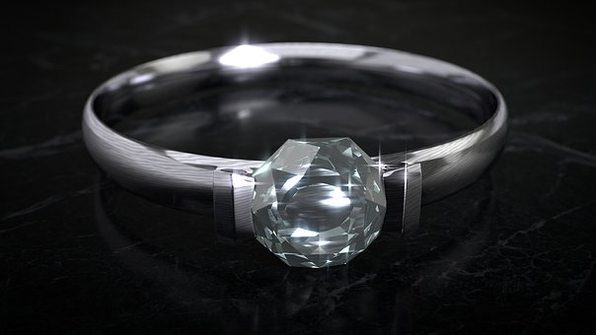
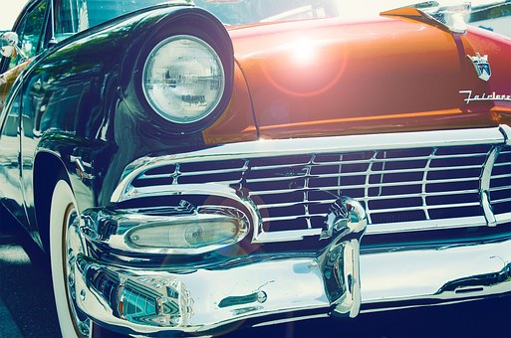
Which metals do we use in our lives every day?
How many types of metal can you name?
Can you name any precious metals?
Why is aluminium used for drinks cans?
Why is silver, gold and platinum used for jewellery?
Why is steel used for vehicle parts?
Notes:
Collect a class list of different types of metals – challenge the children to name as many as they can and discuss the suitability of different metals for different purposes.
Discuss the examples in the slide: aluminium is used for drinks cans because it is lightweight, can be moulded into shape and withstand the pressure of a fizzy drink inside. Explain that precious metals are naturally occurring metals of high value and tend not to change when heated or they are in contact with different substances - as other metals can do. Precious metals can also be shaped without losing toughness and are, therefore, often used to make jewellery. Discuss how one of the most commonly used metals is iron. Explain that iron is used as an ingredient to make steel and this is a strong metal commonly used to make bridges, houses and vehicle parts.

Slide 5
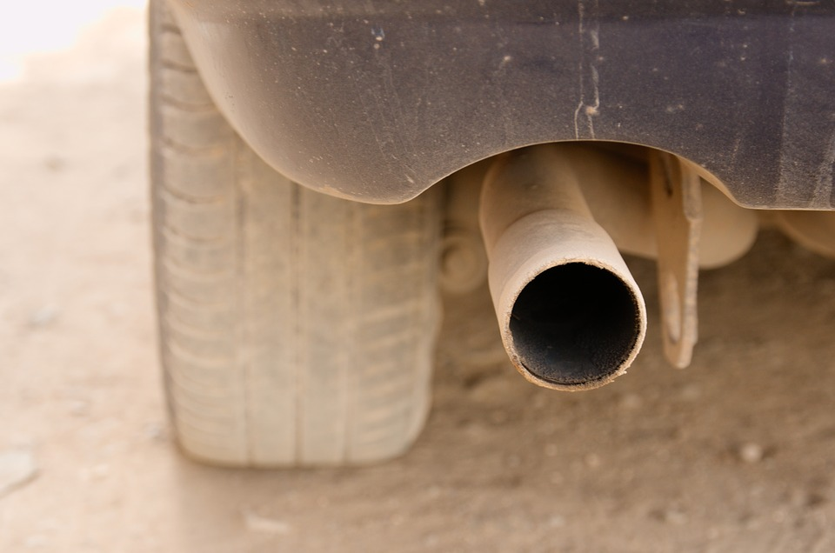
Why do you think there are so many cars on the road today?
How might so many cars have a negative impact on the environment?
There are more than 30 million cars on Britain’s roads today!
Over 77% of households in Great Britain now own a car, compared to 44% since the mid-1960s.
Notes:
Ask children why they think we have so many cars on our roads today and allow time for thinking and discussion. Discuss how reasons might include the increasing population, the falling costs of buying a car and the rise in people, especially women, in work. Think about how cars are more comfortable, faster, more private and more convenient for doing multiple tasks on one trip than almost any form of public transport. Children might talk about air pollution caused by fumes / gases coming out of the exhaust pipe of a vehicle as having a negative impact on the environment.

Slide 6
Dangerous gases are produced by the engine of a vehicle and come out of the exhaust pipe.
Exhaust gases can be poisonous when breathed in, can pollute the water cycle to produce acid rain and can also cause smog.
What do you think can be done to reduce the amount of
dangerous gases from vehicles?
Notes:
Explain that dangerous gases are produced by the engine in any vehicle which runs on petrol or diesel. These gases come out of a vehicle’s exhaust pipe and go into the air. The gases can dissolve in rain, which then damages trees and plants. The gases can also result in smoky fog, called smog and can be poisonous if breathed in in large amounts every day. Some people in countries, such as China, wear masks over the nose and mouth to try to limit the amount of air pollution they are breathing in.
Many people believe that there is no way to avoid the dangerous gases being produced by vehicles. To control this, governments across the world have introduced rules to limit the amount of dangerous gases that can come from vehicles. This means that the people involved in designing and making motor vehicles need to rethink how this can be done. Ask children if hey have any ideas for how to reduce the amount of dangerous gases from vehicles.

Slide 7
There has been an increase in the number of electric vehicles on the roads in recent years.
Are electric cars better for the environment? What do you think?
Electric cars use electricity for power and give out zero dangerous exhaust gases
Harmful global warming gases leave power stations when electricity is produced and this is damaging our environment
Electric cars are a way to use less petrol - which will not last forever
Notes:
The concept cartoon on this slide enables children to discuss and share their initial ideas about electric vehicles and the impact that these may have on the environment. Ask children if they have seen any electric cars either on the road or at charging stations near to school or where they live. This slide also offers the perfect platform for children to use secondary sources of information to carry out their own research into electric vehicles and the possible positive and/or negative opinions that people may have about them.

Slide 8
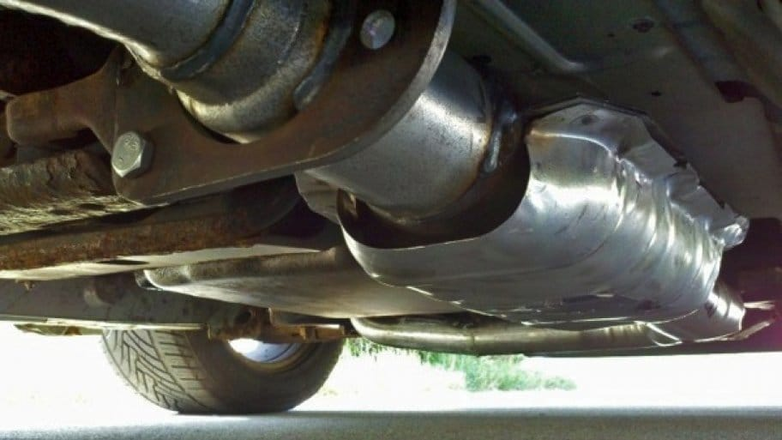
Rethinking Transport: one company’s solution . . .
Scientists and engineers have found a way to turn harmful gases produced in the engine into safe gases, using a catalytic convertor.
Investigations into the use of precious metals have led to the design of something called a catalytic converter which can now be found as part of the exhaust system on motor vehicles.
Notes:
Recap with children that precious metals are relatively “non-reactive”, so they won’t rust or explode when exposed to different substances or high temperatures. This makes them the perfect choice to use as part of a vehicles exhaust system, which will get very hot when the car is running. Catalytic converters can operate at temperatures of 870 degrees Celcius!

Slide 9
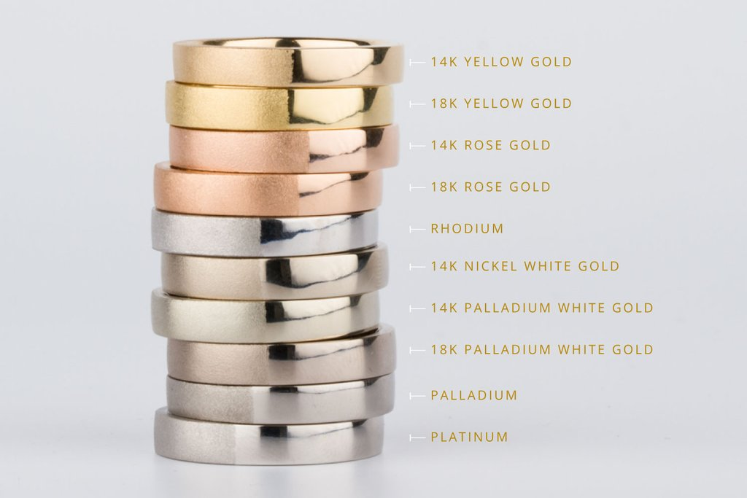
If you look inside of a catalytic converter, you will see small passageways in a honeycomb shaped pattern.
The passage-ways are coated with rare precious metals, such as platinum, rhodium and palladium . Precious metals are chosen because, even at very high temperatures, they do not corrode or change.
As dangerous gases pass through the honeycomb passageways, they react with the precious metals so that the gases flow away much cleaner than what came out of the engine.

Slide 10
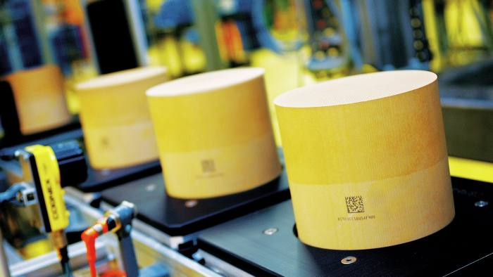
Companies, such as Johnson Matthey at Royston in England, are world leaders
in making catalysts.
Their scientists and engineers have been working for more than forty years
to help make the air cleaner and prevent billions of tons of dangerous gases
from causing pollution.
In 1993, it became law for all petrol cars made in the UK to have a catalytic converter fitted to the exhaust. Thanks to companies like this, the catalytic converter is now the most important part of a vehicle’s exhaust system.
Notes:
Explain that, today, catalytic converters are fitted to cars, trucks, buses, trains, motorcycles and even aeroplanes and this helps to reduce the harmful impact of exhaust emissions on the environment and our health.
It is interesting for children to learn that, after the Clean Air Acts of 1956, 1968 and 1970, Johnson Matthey produced the world’s first emission control catalyst at its site in Royston, This meant that car companies could begin to cut exhaust emissions. There is a plaque on the wall at JM’s facility in Royston which states: ‘Johnson Matthey – the world’s first catalysts to control vehicle pollution were produced in this building in May 1974.’

Slide 11
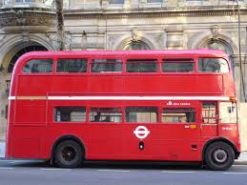
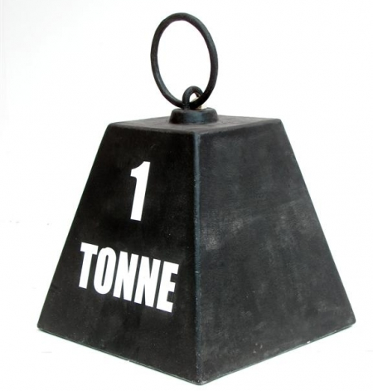
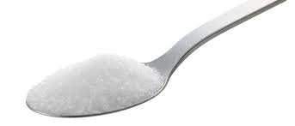
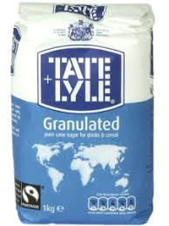
Precious metals are very rare. All the platinum and palladium metal mined in the whole world each year would fit in half a double decker bus!
In precious metal mines, each tonne of rock contains only a few grams of precious metal. It takes lots of energy to dig up and crush the rock and extract the precious metals, which makes them expensive!
When an old car is scrapped, the
precious metal in the catalytic converter
can be reused. A tonne of scrapped
catalysts contains about 2
kilogrammes of precious metal,
so it is more energy efficient
than mining new metal.

Slide 12
www.ciec.org.uk

